Slide 1
Projective Geometry & Homography
Chul Min Yeum
Assistant Professor
Civil and Environmental Engineering
University of Waterloo, Canada
CIVE 497 – CIVE 700: Smart Structure Technology
Last updated: 2018-01-31

Slide 2

ON 3D-CameraMeasure App
Android: https://play.google.com/store/apps/details?id=com.potatotree.on3dcamerameasure

Slide 3

Microsoft Lens

Slide 4
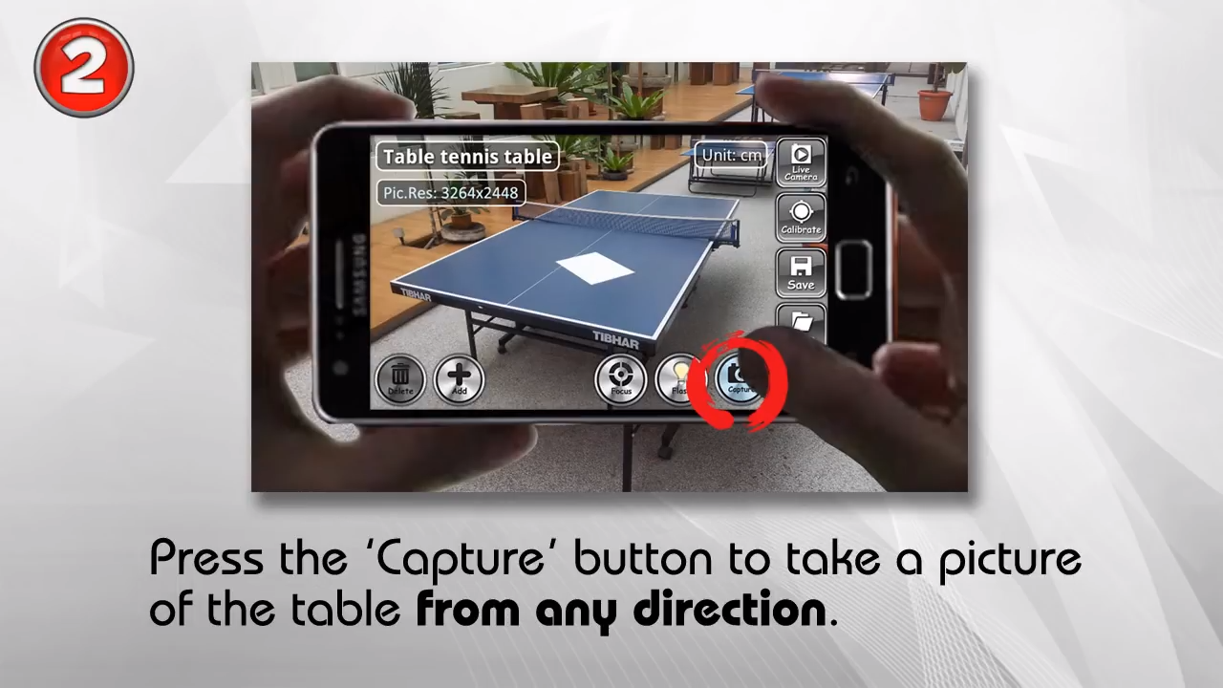
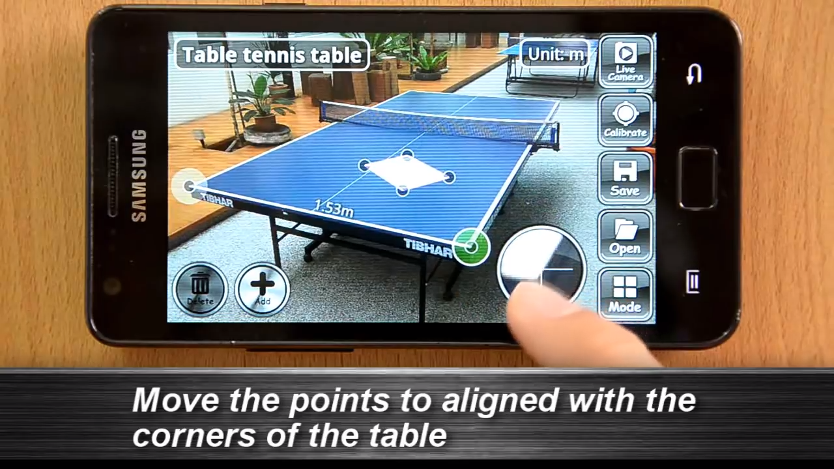
Measurement Demo

Slide 5

Measurement Demo (Continue)

Slide 6
Projective Geometry I and II
We will study this topic using
ECE 661: Computer Vision (by Avinash Kak)
Lecture 2: World 2D: Representing and Manipulating Points, Lines And Conics Using Homogeneous Coordinates
Lecture 3: World 2D: Projective Transformations and Transformation Groups
Lecture 4: Characterization of Distortions Caused by Projective Imaging and the Principle of Point/Line Duality
Lecture 5: Estimating a Plane-to-Plane Homography with Angle-to-Angle and Point-to-Point Correspondences
Course website: https://engineering.purdue.edu/kak/computervision/ECE661Folder/

Slide 7
Lecture 2: World 2D: Representing and Manipulating Points, Lines And Conics Using Homogeneous Coordinates

Slide 8
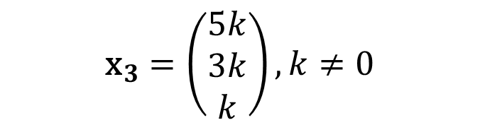
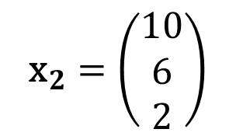
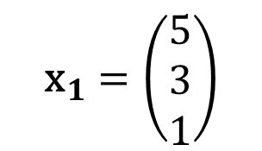

2-1: Point in the Homogeneous Coordinate
An arbitrary homogeneous vector representative of a point is of the form $\text{x}={\left(x_{1},x_{2},x_{3}\right)}^{T}$, representing the point ${\left(x_{1}/x_{3},x_{2}/x_{3}\right)}^{T} \text{in} ℝ^{2}$.
$${\text{x}}_{1}=\left(\begin{matrix}5 \\ 3 \\ 1\end{matrix}\right)$$
$${\text{x}}_{2}=\left(\begin{matrix}10 \\ 6 \\ 2\end{matrix}\right)$$
$${\text{x}}_{3}=\left(\begin{matrix}5k \\ 3k \\ k\end{matrix}\right),k≠0$$
Example)
up to a scale
${\text{x}}_{1},$ ${\text{x}}_{2}$, and ${\text{x}}_{3}$ indicate the same point of (5, 3) in $ℝ^{2}$
$ℝ^{n}$: n-dimension real coordinate system
Notes:
Euclidean space: https://en.wikipedia.org/wiki/Euclidean_space
“ X1 is equal to X3 up to scale”

Slide 9

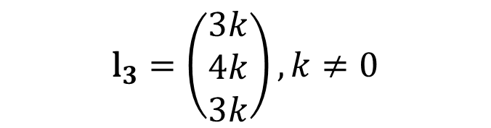

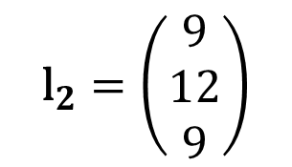
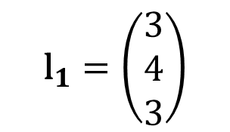

2-1: Line in the Homogeneous Coordinate (HC)
$$ax+by+c=0$$
$$\text{l}={\left(a,b,c\right)}^{⊺}$$
Line equation in $ℝ^{2}$
Line representation in HC
$${\text{l}}_{1}=\left(\begin{matrix}3 \\ 4 \\ 3\end{matrix}\right)$$
$${\text{l}}_{2}=\left(\begin{matrix}9 \\ 12 \\ 9\end{matrix}\right)$$
$${\text{l}}_{3}=\left(\begin{matrix}3k \\ 4k \\ 3k\end{matrix}\right),k≠0$$
Example)
${\text{x}}_{1},$ ${\text{x}}_{2}$, and ${\text{x}}_{3}$ indicate the same line of $3x+4y+3=0$ in $ℝ^{2}$

Slide 10
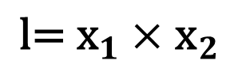

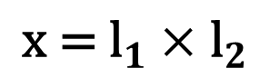
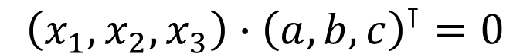
2-1: Points and Lines in the Homogeneous Coordinate (HC)
$$ax+by+c=0$$
$${\left(x_{1},x_{2},x_{3}\right)∙\left(a,b,c\right)}^{⊺}=0$$
The point $\text{x}$ lies on the line $\text{l}$ if and only if $\text{x}{\text{l}}^{⊺}$ =$\text{l}{\text{x}}^{⊺}$= 0.
Given any two lines ${\text{l}}_{1}=(a_{1},b_{1},c_{1})$ and ${\text{l}}_{1}=\left(a_{2},b_{2},c_{2}\right)$, the point ($\text{x}$) of intersection of the two lines :
$${\text{x}\text{ = }\text{l}}_{1}×{\text{l}}_{2}$$
Given any two points ${\text{x}}_{1}=(x_{1},y_{1},z_{1})$ and ${\text{x}}_{2}=\left(x_{2},y_{2},z_{2}\right)$, the line ($\text{l}$) that passes through the two points :
$${\text{l}\text{= }\text{x}}_{1}×{\text{x}}_{2}$$

Slide 11
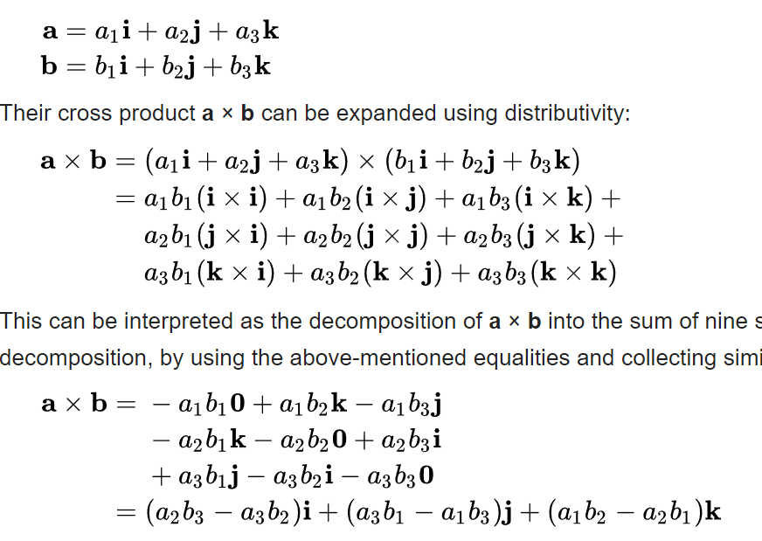
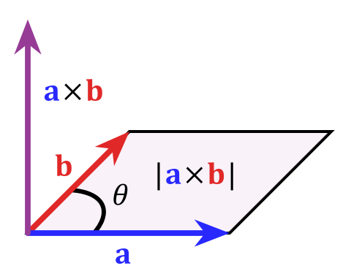
Cross Product
https://en.wikipedia.org/wiki/Cross_product

Slide 12
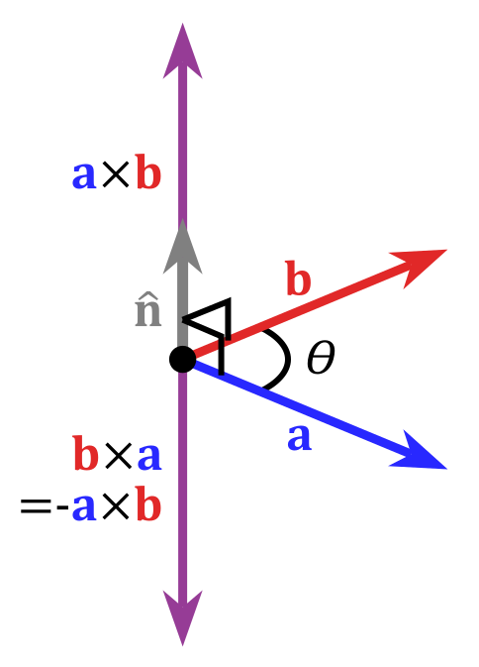
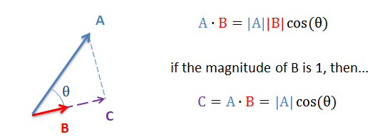
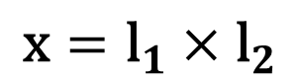
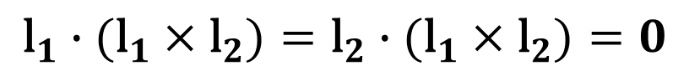
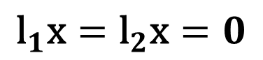
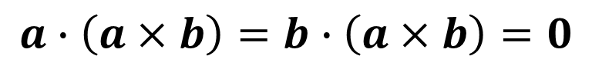
2-2: Prove the Relationship using the Triple Scalar Identity
Dot product
Cross product
$${\text{l}}_{1}\text{x}={\text{l}}_{2}\text{x}=0$$
$$a∙\left(a×b\right)=b∙\left(a×b\right)=0$$
$${\text{l}}_{1}∙({\text{l}}_{1}×{\text{l}}_{2})={\text{l}}_{2}∙({\text{l}}_{1}×{\text{l}}_{2})=0$$
$$\text{x}={\text{l}}_{1}×{\text{l}}_{2}$$
Notes:
https://en.wikipedia.org/wiki/Cross_product

Slide 13
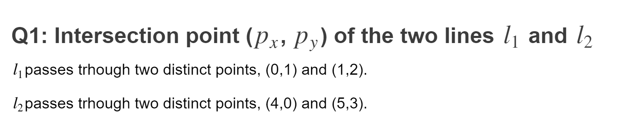
Quiz

Slide 14




2-1 & 2-2: Visualization of Points and Lines in the Homogeneous Coordinate
$$l_{1}$$
$$x_{1}$$
$$x_{2}$$
$$l_{2}$$

Slide 15
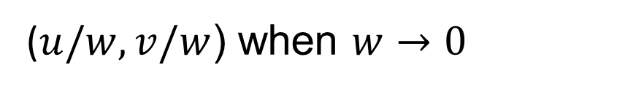
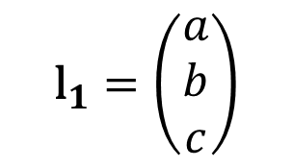
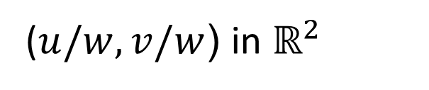
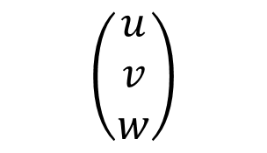
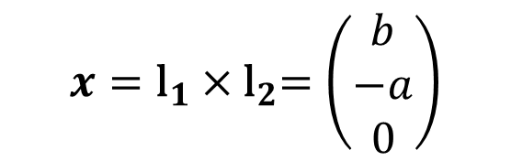
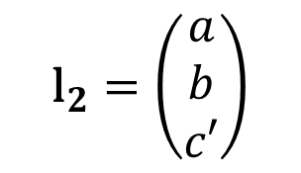
2-2: Ideal Points
$$x={\text{l}}_{1}{×\text{l}}_{2}=\left(\begin{matrix}b \\ −a \\ 0\end{matrix}\right)$$
$${\text{l}}_{1}=\left(\begin{matrix}a \\ b \\ c\end{matrix}\right)$$
$${\text{l}}_{2}=\left(\begin{matrix}a \\ b \\ c′\end{matrix}\right)$$
Ideal points
The point approach to infinity is along a specific direction and the direction being controlled by the value of u and v.
$$\left(\begin{matrix}u \\ v \\ w\end{matrix}\right)$$
($u/w,v/w$) in $ℝ^{2}$
Mathematically!!!
($u/w,v/w$) when $w→0$
Valid the point and line relationship
Notes:
http://juliannakunstler.com/art1_2pt_ch_board.html

Slide 16
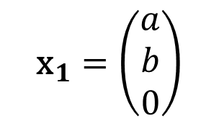
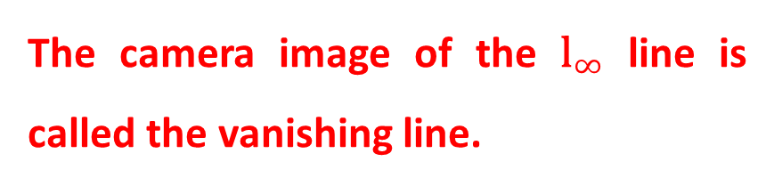

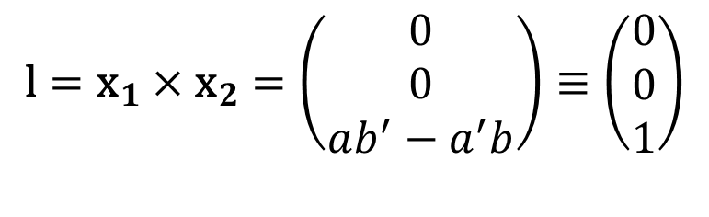
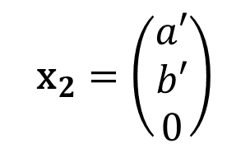
2-3: Vanishing Line
$${\text{x}}_{1}=\left(\begin{matrix}a \\ b \\ 0\end{matrix}\right)$$
$${\text{x}}_{2}=\left(\begin{matrix}a′ \\ b′ \\ 0\end{matrix}\right)$$
$$\text{l}={{\text{x}}_{1}×\text{x}}_{2}=\left(\begin{matrix}0 \\ 0 \\ ab^{′}−a^{′}b\end{matrix}\right)≡\left(\begin{matrix}0 \\ 0 \\ 1\end{matrix}\right)$$
$${\text{l}}_{∞}=\left(\begin{matrix}0 \\ 0 \\ 1\end{matrix}\right)$$
The camera image of the ${\text{l}}_{∞}$ line is called the vanishing line.
Line at infinity
Notes:
http://juliannakunstler.com/art1_2pt_ch_board.html

Slide 17
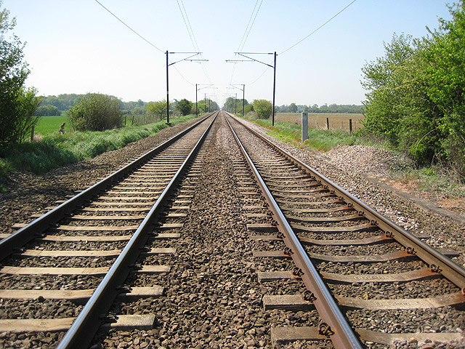
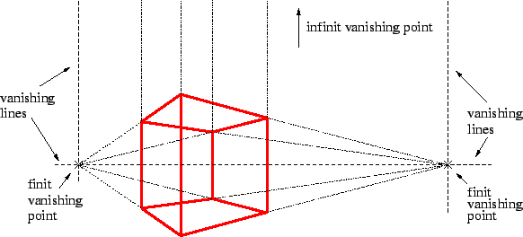
Vanishing Point and Line

Slide 18
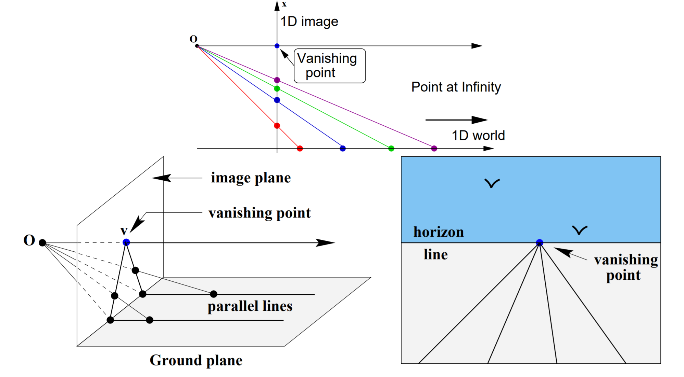
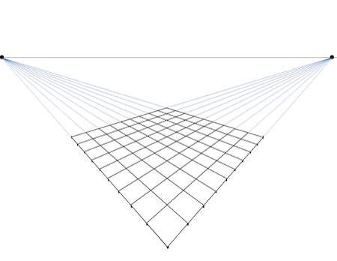
Why All Parallel Lines Meet at One Point?
Vanishing line

Slide 19
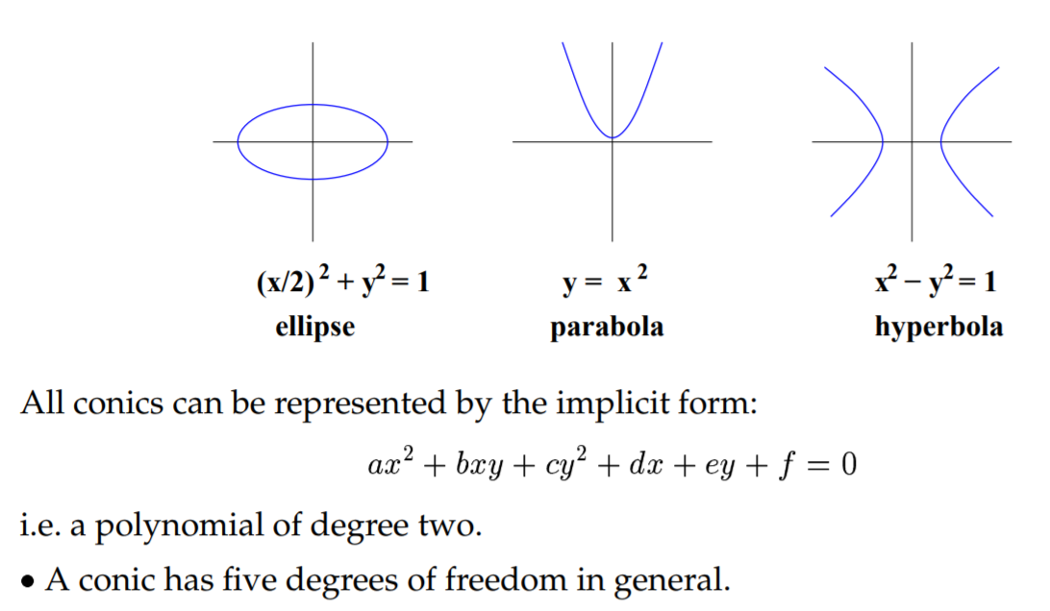
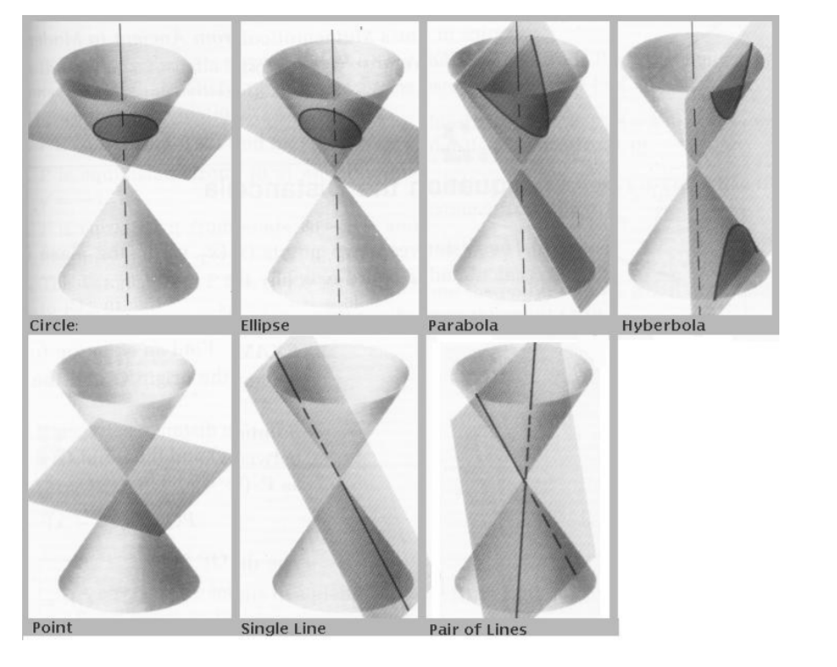
2-3: Conic
$$ax^{2}+b{xy+cy}^{2}+dx+ey+f=0$$
A conic has five degrees of freedom in general
x and y can be represented by the conic equation
Notes:
Implicit function: Implicit function is defined as a relationship between x and y. No distinction can be made between dependent and independent variable.
In other word, x and y can not be separated.
Explicit function: Here, dependent variable is expressed in terms of independent variable. In other word, x and y can be separated.

Slide 20

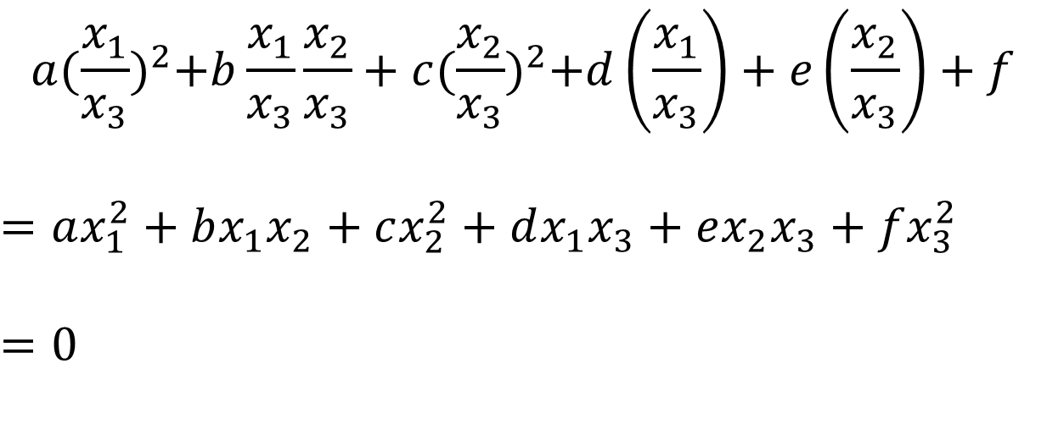

2-3: Conics in HC
$$ax^{2}+bxy+cy^{2}+dx+ey+f=0$$
$\left(x,y\right)$ in $ℝ^{2}$
$$a{(\frac{x_{1}}{x_{3}})}^{2}+b\frac{x_{1}}{x_{3}}\frac{x_{2}}{x_{3}}+c{(\frac{x_{2}}{x_{3}})}^{2}+d\left(\frac{x_{1}}{x_{3}}\right)+e\left(\frac{x_{2}}{x_{3}}\right)+f$$
$$=ax_{1}^{2}+bx_{1}x_{2}+cx_{2}^{2}+dx_{1}x_{3}+ex_{2}x_{3}+fx_{3}^{2}$$
$$=0$$
$\left(x_{1},x_{2},x_{3}\right)$ in $ℍℂ$

Slide 21
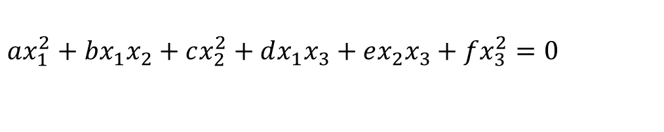

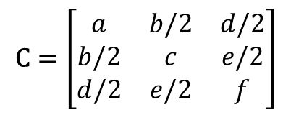
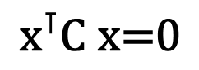
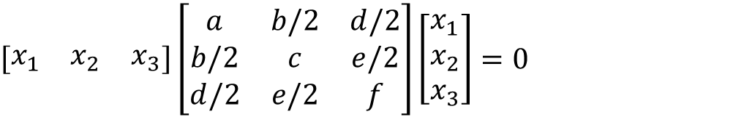
2-3: Conic in HC (Continue)
$$ax_{1}^{2}+bx_{1}x_{2}+cx_{2}^{2}+dx_{1}x_{3}+ex_{2}x_{3}+fx_{3}^{2}=0$$
$\left(x_{1},x_{2},x_{3}\right)$ in $ℍℂ$
$$\left[\begin{matrix}x_{1} & x_{2} & x_{3}\end{matrix}\right]\left[\begin{matrix}a & b/2 & d/2 \\ b/2 & c & e/2 \\ d/2 & e/2 & f\end{matrix}\right]\left[\begin{matrix}x_{1} \\ x_{2} \\ x_{3}\end{matrix}\right]=0$$
$$\text{C}=\left[\begin{matrix}a & b/2 & d/2 \\ b/2 & c & e/2 \\ d/2 & e/2 & f\end{matrix}\right]$$
$\text{C}$is the HC representation of a conic
$${\text{x}}^{⊺}\text{C} \text{x}\text{=0}$$

Slide 22
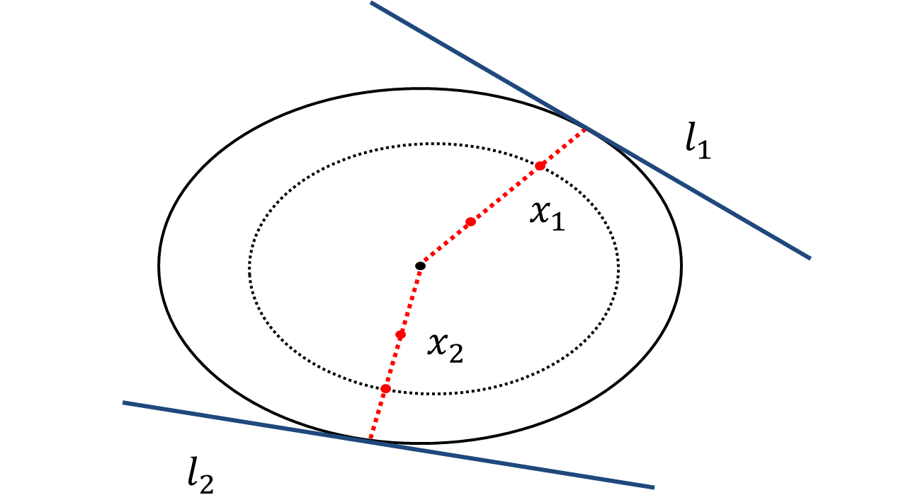
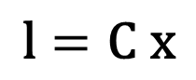
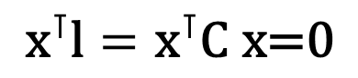
2-4: Conic Property
The HC representation of a conic gives us compact formulas for the tangent lines to a conic.
$${\text{x}}^{⊺}\text{l}={\text{x}}^{⊺}\text{C} \text{x}\text{=0}$$
$$\text{l}=\text{C} \text{x}$$

Slide 23
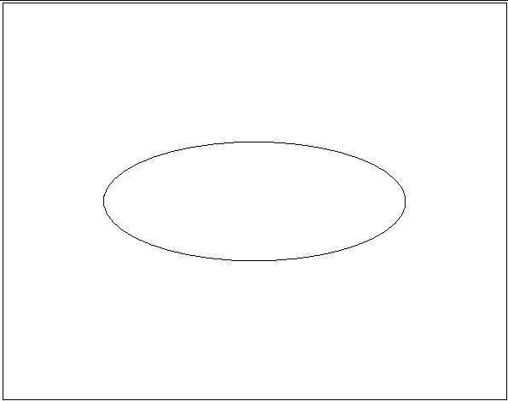
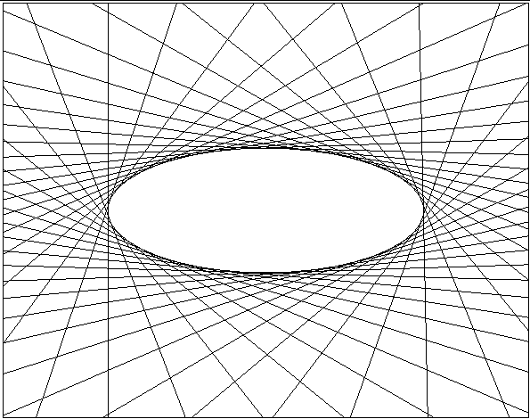
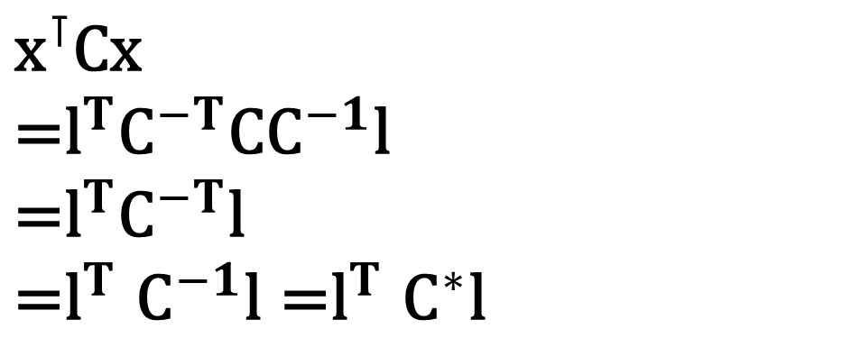
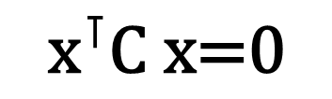
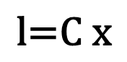
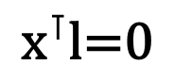
2-4: Dual Conic
$${\text{x}}^{⊺}\text{C}\text{x}$$
$$\text{=}{\text{l}}^{T}{\text{C}}^{−T}\text{C}{\text{C}}^{−1}\text{l}$$
$$\text{=}{\text{l}}^{T}{\text{C}}^{−T}\text{l}$$
$${\text{=}\text{l}}^{T}{\text{C}}^{−1}\text{l}{\text{=}\text{l}}^{T}{\text{C}}^{∗}\text{l}$$
$${\text{x}}^{⊺}\text{C} \text{x}\text{=0}$$
$${\text{x}}^{⊺}\text{l}\text{=0}$$
$$\text{l}\text{=}\text{C} \text{x}$$

Slide 24

2-4: Degenerate Conic
$$\text{C} \text{= }\text{l}{\text{m}}^{⊺ }\text{+ }\text{m}{\text{l}}^{⊺}$$
Two lines constitute a degenerate conic.
$${\text{x}}^{⊺}\text{C} \text{x}\text{=}{\text{x}}^{⊺}\text{(}\text{l}{\text{m}}^{⊺ }\text{+ }\text{m}{\text{l}}^{⊺})\text{x}\text{=0}$$
Two lines constitute a degenerate line conic.
$${\text{l}}^{⊺}{\text{C}}^{∗} \text{l}\text{=}{\text{l}}^{⊺}\text{(}\text{x}{\text{y}}^{⊺ }\text{+}\text{y}{\text{x}}^{⊺})\text{l}\text{=0}$$

Slide 25

Previous Lecture

Slide 26


Quiz

Slide 27


Summary
1. An arbitrary homogeneous vector representative of a point is of the form $\text{x}={\left(x_{1},x_{2},x_{3}\right)}^{T}$, representing the point ${\left(x_{1}/x_{3},x_{2}/x_{3}\right)}^{T} \text{in} ℝ^{2}$.
2. Line equation, $ax+by+c=0$, in $ℝ^{2}$ is represented as $\text{l}={\left(a,b,c\right)}^{⊺}$ in the homogeneous coordinate.
3. A conic, $ax^{2}+bxy+cy^{2}+dx+ey+f=0$, in $ℝ^{2}$ become a 3x3 matrix, $\text{C}$, in the homogeneous coordinate,
$$\text{C}=\left[\begin{matrix}a & b/2 & d/2 \\ b/2 & c & e/2 \\ d/2 & e/2 & f\end{matrix}\right]$$

Slide 28
Lecture 3: World 2D: Projective Transformations and Transformation Groups

Slide 29


Pinhole Camera Model
https://en.wikipedia.org/wiki/Pinhole_camera_model

Slide 30



3-1: Projective Transformation
A planar projective transformation (homography) is a linear transformation on homogeneous 3-vectors, the transformation being represented by a non-singular 3x3 matrix H, as in
$$\left(\begin{matrix}x_{1}^{′} \\ x_{2}^{′} \\ x_{3}^{′}\end{matrix}\right)=\left[\begin{matrix}h_{11} & h_{12} & h_{13} \\ h_{21} & h_{22} & h_{23} \\ h_{31} & h_{32} & h_{33}\end{matrix}\right]\left(\begin{matrix}x_{1} \\ x_{2} \\ x_{3}\end{matrix}\right)$$
$$\text{x}\text{′}=\text{Hx}$$
Notes:
Theorem 2.10.

Slide 31

3-1: Projective Transformation (continue)
In planar perspective transformation, all rays that join a scene point $\text{x}$ with its corresponding image point $\text{x}$’ must pass through the same point that is referred to as the center of projection or the focal center. Obviously , an image formed with a planar perspective transformation will, in general, suffer from distortions including projective, affine, and similarity.

Slide 32







3-1: Property of a Homography
It always maps a straight line to a straight line.
$$\text{x}\text{′}=\text{Hx}$$
$${\text{l}\text{′}}^{⊺}\text{x}\text{′}={\text{l}\text{′}}^{⊺}\text{Hx}\text{ =}{\text{(}\text{l}\text{′}}^{⊺}\text{H}\text{)}\text{x}\text{=}\text{lx}\text{=0}$$
$${\text{l}\text{′}}^{⊺}\text{H}\text{=}\text{l}$$
$${\text{l}\text{′=}\text{H}}^{−⊺}\text{l}$$
Conics
$${\text{x}}^{⊺}\text{C} \text{x}$$
$$\text{=}{\text{(}{\text{H}}^{−1}\text{x}\text{′)}}^{⊺}\text{C}{\text{H}}^{−1}\text{x}\text{′}$$
$$\text{=}{\text{x}}^{′⊺}{\text{H}}^{−⊺}\text{C}{\text{H}}^{−1}\text{x}\text{′}$$
$$\text{=}{\text{x}}^{′⊺}{\text{C}}^{′}\text{x}\text{′}$$
$${\text{x}}^{⊺}\text{C} \text{x}\text{=0}$$

Slide 33
3-2: Hierarchy of Transformation
Projective group
(correct) A similarity transform is an affine transform.
(incorrect) A projective transform is an affine transform.
(correct) An Euclidean transform is an affine transform.
(correct) An affine transform is an projective transform.
(incorrect) An similarity transform is an Euclidean transform.
subgroup of
Affine group
subgroup of
Similarity group
subgroup of
Euclidean group

Slide 34







3-4: Geometric Transformation (Euclidean Transformation)
Rigid body motions
$$\left(\begin{matrix}x_{1}^{′} \\ x_{2}^{′} \\ x_{3}^{′}\end{matrix}\right)=\left[\begin{matrix}1 & 0 & t_{x} \\ 0 & 1 & t_{y} \\ 0 & 0 & 1\end{matrix}\right]\left(\begin{matrix}x_{1} \\ x_{2} \\ x_{3}\end{matrix}\right)$$
$$\text{x}\text{′}=\text{x}+\text{t}$$
$$\left(\begin{matrix}x_{1}^{′} \\ x_{2}^{′} \\ x_{3}^{′}\end{matrix}\right)=\left[\begin{matrix}cosθ & −sinθ & 0 \\ sinθ & cosθ & 0 \\ 0 & 0 & 1\end{matrix}\right]\left(\begin{matrix}x_{1} \\ x_{2} \\ x_{3}\end{matrix}\right)$$
$$\text{x}\text{′}=\text{Rx}$$
$$\left(\begin{matrix}x_{1}^{′} \\ x_{2}^{′} \\ x_{3}^{′}\end{matrix}\right)=\left[\begin{matrix}cosθ & −sinθ & t_{x} \\ sinθ & cosθ & t_{y} \\ 0 & 0 & 1\end{matrix}\right]\left(\begin{matrix}x_{1} \\ x_{2} \\ x_{3}\end{matrix}\right)$$
See tutorials
$$\text{x}\text{′}=\text{Rx}+\text{t}$$

Slide 35



Example
Translation
Rotation

Slide 36




3-4: Geometric Transformation (Similarity Transformation)
Preserve angles and ratios of lengths => Preserve “shape” (isotropic scale)
$$\left(\begin{matrix}x_{1}^{′} \\ x_{2}^{′} \\ x_{3}^{′}\end{matrix}\right)=\left[\begin{matrix}s & 0 & t_{x} \\ 0 & s & t_{y} \\ 0 & 0 & 1\end{matrix}\right]\left(\begin{matrix}x_{1} \\ x_{2} \\ x_{3}\end{matrix}\right)$$
$$\left(\begin{matrix}x_{1}^{′} \\ x_{2}^{′} \\ x_{3}^{′}\end{matrix}\right)=\left[\begin{matrix}s∗cosθ & −s∗sinθ & t_{x} \\ s∗sinθ & s∗cosθ & t_{y} \\ 0 & 0 & 1\end{matrix}\right]\left(\begin{matrix}x_{1} \\ x_{2} \\ x_{3}\end{matrix}\right)$$
$$\text{x}\text{′}=s\text{Rx}+\text{t}$$
See tutorials

Slide 37

Example
Scale

Slide 38


3-3 & 3-4: Geometric Transformation (Affine Transformation)
Keep parallel lines parallel.
$$\left(\begin{matrix}x_{1}^{′} \\ x_{2}^{′} \\ x_{3}^{′}\end{matrix}\right)=\left[\begin{matrix}a_{11} & a_{12} & t_{x} \\ a_{21} & a_{22} & t_{y} \\ 0 & 0 & 1\end{matrix}\right]\left(\begin{matrix}x_{1} \\ x_{2} \\ x_{3}\end{matrix}\right)$$
$$\text{A}=\left[\begin{matrix}a_{11} & a_{12} \\ a_{21} & a_{22}\end{matrix}\right]$$

Slide 39


3-4: Algebraic Understanding on Affine Transformation
Singular value decomposition (SVD)
$$\text{A}\text{=}\text{UD}{\text{V}}^{\text{⊺}}\text{=(}\text{U}{\text{V}}^{\text{⊺}}\text{)(}{\text{VDV}}^{\text{⊺}}\text{)}\text{=}\text{R}\text{(}θ\text{)}\text{R}\text{(−}ϕ\text{)}\text{DR}\text{(}ϕ\text{)}$$
U, V: Orthonormal matrix
D: Diagonal matrix
Product of two orthonormal matrices become an orthonormal matrix
Every orthonormal matrix having determinant 1 acts as a rotation.
Notes:
https://math.stackexchange.com/questions/1416726/why-is-the-matrix-product-of-2-orthogonal-matrices-also-an-orthogonal-matrix

Slide 40



3-4: Algebraic Understanding on Affine Transformation
$$\text{A}\text{=}\text{UD}{\text{V}}^{\text{⊺}}\text{=(}\text{U}{\text{V}}^{\text{⊺}}\text{)(}{\text{VDV}}^{\text{⊺}}\text{)}\text{=}\text{R}\text{(}θ\text{)}\text{R}\text{(}ϕ\text{)}\left[\begin{matrix}λ_{1} & 0 \\ 0 & λ_{2}\end{matrix}\right]\text{R}\text{(}ϕ\text{)}$$
The affine matrix A is seen to be the concatenation of a rotation (by $φ$); a scaling by $λ_{1}$ and $λ_{2}$ respectively in the (rotated) x and y directions ; a rotation back (by $−φ$); and finally another rotation (by $θ$). The only “new” geometry, compared to a similarity, is the non-isotropic scaling.
See tutorials
Notes:
https://math.stackexchange.com/questions/1416726/why-is-the-matrix-product-of-2-orthogonal-matrices-also-an-orthogonal-matrix

Slide 41





Example: Decomposition of Affine Transformation
$$\left[\begin{matrix}λ_{1} & 0 \\ 0 & λ_{2}\end{matrix}\right]\text{R}\text{(}ϕ\text{)}$$
$$\text{R}\text{(}ϕ\text{)}$$
$$\text{R}\text{(}ϕ\text{)}\left[\begin{matrix}λ_{1} & 0 \\ 0 & λ_{2}\end{matrix}\right]\text{R}\text{(}ϕ\text{)}$$
$$\text{A}\text{=}\text{R}\text{(}θ\text{)}\text{R}\text{(}ϕ\text{)}\left[\begin{matrix}λ_{1} & 0 \\ 0 & λ_{2}\end{matrix}\right]\text{R}\text{(}ϕ\text{)}$$
$$\text{R}\text{(}θ\text{)}\text{R}\text{(}ϕ\text{)}\left[\begin{matrix}λ_{1} & 0 \\ 0 & λ_{2}\end{matrix}\right]\text{R}\text{(}ϕ\text{)}$$

Slide 42



3-4: Geometric Transformation (Projective Transformation)
$$\left(\begin{matrix}x_{1}^{′} \\ x_{2}^{′} \\ x_{3}^{′}\end{matrix}\right)=\left[\begin{matrix}h_{11} & h_{12} & h_{13} \\ h_{21} & h_{22} & h_{23} \\ h_{31} & h_{32} & h_{33}\end{matrix}\right]\left(\begin{matrix}x_{1} \\ x_{2} \\ x_{3}\end{matrix}\right)$$
$$Cross ratio$$

Slide 43



3-4: Decomposition of a Project Transformation
$$\left(\begin{matrix}x_{1}^{′} \\ x_{2}^{′} \\ x_{3}^{′}\end{matrix}\right)=\left[\begin{matrix}s∗cosθ & −s∗sinθ & t_{x} \\ s∗sinθ & s∗cosθ & t_{y} \\ 0 & 0 & 1\end{matrix}\right]\left(\begin{matrix}x_{1} \\ x_{2} \\ x_{3}\end{matrix}\right)=\left[\begin{matrix}\text{s}\text{R} & \text{t} \\ {\text{0}}^{\text{⊺}} & 1\end{matrix}\right]\left(\begin{matrix}x_{1} \\ x_{2} \\ x_{3}\end{matrix}\right)$$
Similarity
$$\left(\begin{matrix}x_{1}^{′} \\ x_{2}^{′} \\ x_{3}^{′}\end{matrix}\right)=\left[\begin{matrix}a_{11} & a_{12} & t_{x} \\ a_{21} & a_{22} & t_{y} \\ 0 & 0 & 1\end{matrix}\right]\left(\begin{matrix}x_{1} \\ x_{2} \\ x_{3}\end{matrix}\right)$$
Affine
$$\text{H}\text{=}{\text{H}}_{S}{\text{H}}_{A}{\text{H}}_{P}=\left[\begin{matrix}\text{s}\text{R} & \text{t} \\ {\text{0}}^{\text{⊺}} & 1\end{matrix}\right]\left[\begin{matrix}K & \text{0} \\ {\text{0}}^{\text{⊺}} & 1\end{matrix}\right]\left[\begin{matrix}I & \text{0} \\ {\text{v}}^{\text{⊺}} & v\end{matrix}\right]$$

Slide 44


3-4: Decomposition of a Project Transformation (Continue)
$$\text{H}\text{=}{\text{H}}_{S}{\text{H}}_{A}{\text{H}}_{P}=\left[\begin{matrix}\text{s}\text{R} & \text{t} \\ {\text{0}}^{\text{⊺}} & 1\end{matrix}\right]\left[\begin{matrix}K & \text{0} \\ {\text{0}}^{\text{⊺}} & 1\end{matrix}\right]\left[\begin{matrix}I & \text{0} \\ {\text{v}}^{\text{⊺}} & v\end{matrix}\right]$$
$${\text{H}}^{−1}\text{=}{{\text{H}}_{P}}^{−1}{{\text{H}}_{A}}^{−1}{{\text{H}}_{S}}^{−1}$$
Matrix inverse
See tutorials
$$\text{H}\text{=}{\text{H}}_{P}{\text{H}}_{A}{\text{H}}_{S}=\left[\begin{matrix}I & \text{0} \\ {\text{v}}^{\text{⊺}} & v\end{matrix}\right]\left[\begin{matrix}K & \text{0} \\ {\text{0}}^{\text{⊺}} & 1\end{matrix}\right]\left[\begin{matrix}\text{s}\text{R} & \text{t} \\ {\text{0}}^{\text{⊺}} & 1\end{matrix}\right]$$

Slide 45

Summary

Slide 46

Lecture 4: Characterization of Distortions Caused by Projective Imaging and the Principle of Point/Line Duality

Slide 47



4-1: Projective Distortion
No distortion
Projective distortion
Lens distortion
Notes:
https://www.pexels.com/photo/arches-architecture-bar-building-305832/
https://www.pexels.com/photo/apartment-architecture-buildings-business-425047/
https://unsplash.com/photos/j_MgyPHGRP0

Slide 48








4-1: Affine Transformation
A projective transformation H is affine if and only if ${\text{l}}_{∞}$ is mapped to ${\text{l}}_{∞}$.
$${{\text{l}}_{∞}\text{=}\text{H}}^{−⊺}{\text{l}}_{∞}$$
$$\left(\begin{matrix}x_{1}^{′} \\ x_{2}^{′} \\ x_{3}^{′}\end{matrix}\right)=\left[\begin{matrix}\text{A} & \text{t} \\ 0 & 1\end{matrix}\right]\left(\begin{matrix}x_{1} \\ x_{2} \\ x_{3}\end{matrix}\right)$$
$${\text{l}}_{∞}=\left(\begin{matrix}0 \\ 0 \\ 1\end{matrix}\right)$$
$$\text{t}=\left[\begin{matrix}t_{x} \\ t_{y}\end{matrix}\right]$$
$$\text{A}=\left[\begin{matrix}a_{11} & a_{12} \\ a_{21} & a_{22}\end{matrix}\right]$$
$$\text{H}=\left[\begin{matrix}\text{A} & \text{t} \\ 0 & 1\end{matrix}\right]$$
$${\text{H}}^{−⊺}=\left[\begin{matrix}{\text{A}}^{−⊺} & \text{0} \\ {\text{−}\text{t}\text{A}}^{−⊺} & 1\end{matrix}\right]$$

Slide 49
4-2: Projective Transformation
Vanishing point
Parallel
Vanishing line
Parallel
Vanishing point
Affine Transformation
Projective Transformation
Whereas every affine transformation maps ${\text{l}}_{∞}$ to ${\text{l}}_{∞}$, a general projective transform maps ${\text{l}}_{∞}$ to a physical line that we call the vanishing line.

Slide 50



4-2: Affine Rectification
Parallel
Vanishing line
$${\text{H}}_{P}$$
$$\text{H}$$
Parallel
$${\text{H}}_{A}$$

Slide 51




4-2: Affine Rectification (Continue)
Parallel
Vanishing line ($l$)
$$l=\left(\begin{matrix}l_{1} \\ l_{2} \\ l_{3}\end{matrix}\right)$$
$$\text{H}$$
Parallel
$$\text{H}=\left[\begin{matrix}1 & 0 & 0 \\ 0 & 1 & 0 \\ l_{1} & l_{2} & l_{3}\end{matrix}\right]$$
See tutorials
Invariant
See lecture note

Slide 52
Lecture 5: Characterization of Distortions Caused by Projective Imaging and the Principle of Point/Line Duality

Slide 53
Previous Lecture

Slide 54


4-3 & 4-4: Circular Points
A projective transformation H is affine if and only if ${\text{l}}_{∞}$ is mapped to ${\text{l}}_{∞}$.
A projective transformation H is similarity if and only if circular points are mapped to circular points.
$$\left[\begin{matrix}s∗cosθ & −s∗sinθ & t_{x} \\ s∗sinθ & s∗cosθ & t_{y} \\ 0 & 0 & 1\end{matrix}\right]\left(\begin{matrix}1 \\ i \\ 0\end{matrix}\right)$$
$$=\left(\begin{matrix}s∗cosθ−s∗i∗sinθ \\ s∗sinθ+s∗i∗cosθ \\ 0\end{matrix}\right)$$
$≅\left(\begin{matrix}cosθ−i∗sinθ \\ sinθ+i∗cosθ \\ 0\end{matrix}\right)$ $≅(cosθ−i∗sinθ)\left(\begin{matrix}1 \\ i \\ 0\end{matrix}\right)≅\left(\begin{matrix}1 \\ i \\ 0\end{matrix}\right)$
$\text{I}=\left(\begin{matrix}1 \\ i \\ 0\end{matrix}\right)$
$\text{J}=\left(\begin{matrix}1 \\ −i \\ 0\end{matrix}\right)$
$$i:complex number$$

Slide 55


4-4: Dual Degenerate Conic
$${\text{C}}_{∞}^{∗}=\left(\begin{matrix}1 \\ i \\ 0\end{matrix}\right)\left(\begin{matrix}1 & −i & 0\end{matrix}\right)+\left(\begin{matrix}1 \\ −i \\ 0\end{matrix}\right)\left(\begin{matrix}1 & i & 0\end{matrix}\right)=\left[\begin{matrix}1 & 0 & 0 \\ 0 & 1 & 0 \\ 0 & 0 & 0\end{matrix}\right]$$

Slide 56










5-1: Angles between Two Lines
$$\left(\begin{matrix}m_{1} \\ m_{2}\end{matrix}\right)$$
$$Y$$
$$\text{l}=\left(\begin{matrix}l_{1} \\ l_{2} \\ l_{3}\end{matrix}\right)$$
$$\text{l}:l_{1}x+l_{2}y+l_{3}=0$$
$$\text{m}:m_{1}x+m_{2}y+m_{3}=0$$
$$θ$$
$$\left(\begin{matrix}l_{1} \\ l_{2}\end{matrix}\right)$$
Dot product
$$θ$$
$$X$$
$$\text{m}=\left(\begin{matrix}m_{1} \\ m_{2} \\ m_{3}\end{matrix}\right)$$
$$cosθ=\frac{l_{1}m_{1}+l_{2}m_{2}}{\sqrt{(l_{1}^{2}+l_{2}^{2})(m_{1}^{2}+m_{2}^{2})}}$$

Slide 57






5-1: Representation of an angle using Dual Degenerate Conic
$$\text{l}=\left(\begin{matrix}l_{1} \\ l_{2} \\ l_{3}\end{matrix}\right)$$
$$\text{m}=\left(\begin{matrix}m_{1} \\ m_{2} \\ m_{3}\end{matrix}\right)$$
$$\text{l}:l_{1}x+l_{2}y+l_{3}=0$$
$$\text{m}:m_{1}x+m_{2}y+m_{3}=0$$
$$cosθ=\frac{l_{1}m_{1}+l_{2}m_{2}}{\sqrt{(l_{1}^{2}+l_{2}^{2})(m_{1}^{2}+m_{2}^{2})}}$$
$$cosθ=\frac{{l^{T}\text{C}}_{∞}^{∗}m}{\sqrt{({l^{T}\text{C}}_{∞}^{∗}l)({m^{T}\text{C}}_{∞}^{∗}m)}}$$
$${\text{C}}_{∞}^{∗}=\left[\begin{matrix}1 & 0 & 0 \\ 0 & 1 & 0 \\ 0 & 0 & 0\end{matrix}\right]$$

Slide 58


5-2: Similarity Rectification
A projective transformation H is similarity if and only if circular points are mapped to circular points.
$$cosθ=\frac{{l^{T}\text{C}}_{∞}^{∗}m}{\sqrt{({l^{T}\text{C}}_{∞}^{∗}l)({m^{T}\text{C}}_{∞}^{∗}m)}}$$
Similarity transformation
${l^{T}\text{C}}_{∞}^{∗}m=0$
when lines $l$ and $m$ are orthogonal.

Slide 59





5-2: Metric Rectification using${\text{C}}_{∞}^{∗}$
$$\left(\begin{matrix}x_{1}^{′} \\ x_{2}^{′} \\ x_{3}^{′}\end{matrix}\right)=\left[\begin{matrix}h_{11} & h_{12} & h_{13} \\ h_{21} & h_{22} & h_{23} \\ h_{31} & h_{32} & h_{33}\end{matrix}\right]\left(\begin{matrix}x_{1} \\ x_{2} \\ x_{3}\end{matrix}\right)$$
$$\text{x}\text{′}=\text{Hx}$$
$${\text{l}\text{′=}\text{H}}^{−⊺}\text{l}$$
$$\text{H}\text{=}{\text{H}}_{P}{\text{H}}_{A}{\text{H}}_{S}=\left[\begin{matrix}I & \text{0} \\ {\text{v}}^{\text{⊺}} & v\end{matrix}\right]\left[\begin{matrix}K & \text{0} \\ {\text{0}}^{\text{⊺}} & 1\end{matrix}\right]\left[\begin{matrix}\text{s}\text{R} & \text{t} \\ {\text{0}}^{\text{⊺}} & 1\end{matrix}\right]$$
$${l^{⊺}\text{C}}_{∞}^{∗}m$$
$$=l^{⊺}{\text{H}}^{−1}{\text{HC}}_{∞}^{∗}{\text{H}}^{⊺}{\text{H}}^{−⊺}m$$
$$={\text{(}{\text{H}}^{−⊺}l\text{)}}^{⊺}{\text{HC}}_{∞}^{∗}{\text{H}}^{⊺}({\text{H}}^{−⊺}m)$$
$$\text{=} {\text{l}\text{′}}^{⊺}{\text{C}}_{∞}^{∗}′\text{m}\text{′}$$
${\text{C}}_{∞}^{∗}′$ =${\text{HC}}_{∞}^{∗}{\text{H}}^{⊺}$
$$\text{= }\text{(}{\text{H}}_{P}{{\text{H}}_{A}\text{H}}_{S}\text{)} {\text{C}}_{∞}^{∗}{ \text{(}{\text{H}}_{P}{{\text{H}}_{A}\text{H}}_{S}\text{)}}^{⊺}$$
$$\text{= (}{\text{H}}_{P}{{\text{H}}_{A}\text{H}}_{S}\text{)} {\text{C}}_{∞}^{∗}{{\text{H}}_{S}}^{⊺}{{\text{H}}_{A}}^{⊺}{{\text{H}}_{P}}^{⊺}$$
$$\text{= }{\text{H}}_{P}{{\text{H}}_{A}\text{(}\text{H}}_{S} {\text{C}}_{∞}^{∗}{{\text{H}}_{S}}^{⊺}){{\text{H}}_{A}}^{⊺}{{\text{H}}_{P}}^{⊺}$$
$$\text{= }{\text{H}}_{P}{\text{H}}_{A}{\text{C}}_{∞}^{∗}{{\text{H}}_{A}}^{⊺}{{\text{H}}_{P}}^{⊺}$$

Slide 60



$${\text{H}}_{S} {\text{C}}_{∞}^{∗}{{\text{H}}_{S}}^{⊺}={\text{C}}_{∞}^{∗}$$
$${\text{C}}_{∞}^{∗}=\left[\begin{matrix}1 & 0 & 0 \\ 0 & 1 & 0 \\ 0 & 0 & 0\end{matrix}\right]$$
$$H_{s}=\left[\begin{matrix}s∗cosθ & −s∗sinθ & t_{x} \\ s∗sinθ & s∗cosθ & t_{y} \\ 0 & 0 & 1\end{matrix}\right]$$
$$\left[\begin{matrix}s∗cosθ & −s∗sinθ & t_{x} \\ s∗sinθ & s∗cosθ & t_{y} \\ 0 & 0 & 1\end{matrix}\right]\left[\begin{matrix}1 & 0 & 0 \\ 0 & 1 & 0 \\ 0 & 0 & 0\end{matrix}\right]\left[\begin{matrix}s∗cosθ & s∗sinθ & 0 \\ −s∗sinθ & s∗cosθ & 0 \\ t_{x} & t_{y} & 1\end{matrix}\right]≡\left[\begin{matrix}1 & 0 & 0 \\ 0 & 1 & 0 \\ 0 & 0 & 0\end{matrix}\right]$$

Slide 61

5-2: Metric Rectification using${\text{C}}_{∞}^{∗}$
${\text{C}}_{∞}^{∗}′$ =${\text{HC}}_{∞}^{∗}{\text{H}}^{⊺}$
$$\text{= }\text{(}{\text{H}}_{P}{{\text{H}}_{A}\text{H}}_{S}\text{)} {\text{C}}_{∞}^{∗}{ \text{(}{\text{H}}_{P}{{\text{H}}_{A}\text{H}}_{S}\text{)}}^{⊺}$$
$$\text{= (}{\text{H}}_{P}{{\text{H}}_{A}\text{H}}_{S}\text{)} {\text{C}}_{∞}^{∗}{{\text{H}}_{S}}^{⊺}{{\text{H}}_{A}}^{⊺}{{\text{H}}_{P}}^{⊺}$$
$$\text{= }{\text{H}}_{P}{{\text{H}}_{A}\text{(}\text{H}}_{S} {\text{C}}_{∞}^{∗}{{\text{H}}_{S}}^{⊺}){{\text{H}}_{A}}^{⊺}{{\text{H}}_{P}}^{⊺}$$
$$\text{= }{\text{H}}_{P}{\text{H}}_{A}{\text{C}}_{∞}^{∗}{{\text{H}}_{A}}^{⊺}{{\text{H}}_{P}}^{⊺}$$
$$\text{=}\left[\begin{matrix}I & \text{0} \\ {\text{v}}^{\text{⊺}} & v\end{matrix}\right]\left[\begin{matrix}K & \text{0} \\ {\text{0}}^{\text{⊺}} & 1\end{matrix}\right]\left[\begin{matrix}1 & 0 & 0 \\ 0 & 1 & 0 \\ 0 & 0 & 0\end{matrix}\right]\left[\begin{matrix}{\text{K}}^{\text{⊺}} & \text{0} \\ {\text{0}}^{\text{⊺}} & 1\end{matrix}\right]\left[\begin{matrix}I & {\text{v}}^{\text{⊺}} \\ {\text{0}}^{\text{⊺}} & v\end{matrix}\right]$$
= $\left[\begin{matrix}KK^{\text{⊺}} & KK^{\text{⊺}}\text{v} \\ {\text{v}}^{\text{⊺}}KK^{\text{⊺}} & {\text{v}}^{\text{⊺}}KK^{\text{⊺}}\text{v}\end{matrix}\right]$
$$\text{H}\text{=}{\text{H}}_{P}{\text{H}}_{A}{\text{H}}_{S}=\left[\begin{matrix}I & \text{0} \\ {\text{v}}^{\text{⊺}} & v\end{matrix}\right]\left[\begin{matrix}K & \text{0} \\ {\text{0}}^{\text{⊺}} & 1\end{matrix}\right]\left[\begin{matrix}\text{s}\text{R} & \text{t} \\ {\text{0}}^{\text{⊺}} & 1\end{matrix}\right]$$
6-dof problem (5-dof up to scale)
K: 4-dof
V: 2-dof

Slide 62







5-2: Metric Rectification using${\text{C}}_{∞}^{∗}$
$${l^{⊺}\text{C}}_{∞}^{∗}m={\text{l}\text{′}}^{⊺}{\text{C}}_{∞}^{∗}′\text{m}\text{′=}{\text{l}\text{′}}^{⊺}\left[\begin{matrix}KK^{\text{⊺}} & KK^{\text{⊺}}\text{v} \\ {\text{v}}^{\text{⊺}}KK^{\text{⊺}} & {\text{v}}^{\text{⊺}}KK^{\text{⊺}}\text{v}\end{matrix}\right]\text{m}\text{′=0}$$
$$\text{H}\text{=}{\text{H}}_{P}{\text{H}}_{A}{\text{H}}_{S}=\left[\begin{matrix}I & \text{0} \\ {\text{v}}^{\text{⊺}} & v\end{matrix}\right]\left[\begin{matrix}K & \text{0} \\ {\text{0}}^{\text{⊺}} & 1\end{matrix}\right]\left[\begin{matrix}\text{s}\text{R} & \text{t} \\ {\text{0}}^{\text{⊺}} & 1\end{matrix}\right]$$
$${\text{H}}_{S}$$
$${\text{H}}_{A}$$
$${\text{H}}_{P}$$
$$l, m$$
$\text{l}\text{′}$, $\text{m}\text{′}$
$$\text{H}$$
Notes:
I don’t know what H is.
H can be decomposed into Hp, HA, Hs
Using some features, we can recover its distortion up to similarity.

Slide 63



Metric Rectification I: Two-step Method (Example 2.26)
$${l^{⊺}\text{C}}_{∞}^{∗}m={\text{l}\text{′}}^{⊺}{\text{C}}_{∞}^{∗}′\text{m}\text{′=}{\text{l}\text{′}}^{⊺}\left[\begin{matrix}KK^{\text{⊺}} & 0 \\ 0 & 0\end{matrix}\right]\text{m}\text{′=0}$$
$$\text{H}\text{=}{\text{H}}_{A}{\text{H}}_{S}=\left[\begin{matrix}K & \text{0} \\ {\text{0}}^{\text{⊺}} & 1\end{matrix}\right]\left[\begin{matrix}\text{s}\text{R} & \text{t} \\ {\text{0}}^{\text{⊺}} & 1\end{matrix}\right]$$
3-dof problem (2-dof up to scale)
$${\text{l}\text{′}}^{⊺}\left[\begin{matrix}KK^{\text{⊺}} & 0 \\ 0 & 0\end{matrix}\right]\text{m}\text{′=}\left[\begin{matrix}l_{1} & l_{2} & l_{3}\end{matrix}\right]\left[\begin{matrix}s_{1} & s_{2} & 0 \\ s_{2} & s_{3} & 0 \\ 0 & 0 & 0\end{matrix}\right]\left[\begin{matrix}m_{1} \\ m_{2} \\ m_{3}\end{matrix}\right]=0$$
$$\left[\begin{matrix}l_{1}m_{1} & l_{1}m_{2}+l_{2}m_{1} & l_{2}m_{2}\end{matrix}\right]\left[\begin{matrix}s_{1} \\ s_{2} \\ s_{3}\end{matrix}\right]=0$$

Slide 64




Metric Rectification II: One-step Method (Example 2.27)
$${l^{⊺}\text{C}}_{∞}^{∗}m={\text{l}\text{′}}^{⊺}{\text{C}}_{∞}^{∗}′\text{m}\text{′=}{\text{l}\text{′}}^{⊺}\left[\begin{matrix}KK^{\text{⊺}} & KK^{\text{⊺}}\text{v} \\ {\text{v}}^{\text{⊺}}KK^{\text{⊺}} & {\text{v}}^{\text{⊺}}KK^{\text{⊺}}\text{v}\end{matrix}\right]\text{m}\text{′=0}$$
$$\text{C}=\left[\begin{matrix}a & b/2 & d/2 \\ b/2 & c & e/2 \\ d/2 & e/2 & f\end{matrix}\right]$$
6-dof problem (5-dof up to scale)
$${\text{l}\text{′}}^{⊺}\left[\begin{matrix}KK^{\text{⊺}} & KK^{\text{⊺}}\text{v} \\ {\text{v}}^{\text{⊺}}KK^{\text{⊺}} & {\text{v}}^{\text{⊺}}KK^{\text{⊺}}\text{v}\end{matrix}\right]\text{m}\text{′ =}\left[\begin{matrix}l_{1} & l_{2} & l_{3}\end{matrix}\right]\left[\begin{matrix}a & b & c \\ b & d & e \\ c & e & f\end{matrix}\right]\left[\begin{matrix}m_{1} \\ m_{2} \\ m_{3}\end{matrix}\right]=0$$
$$\left[\begin{matrix}l_{1}m_{1} & l_{1}m_{2}+l_{2}m_{1} & \begin{matrix}l_{1}m_{3}+l_{3}m_{1} & l_{2}m_{2} & \begin{matrix}l_{2}m_{3}+l_{3}m_{2} & l_{3}m_{3}\end{matrix}\end{matrix}\end{matrix}\right]\left[\begin{matrix}a \\ b \\ \begin{matrix}c \\ d \\ \begin{matrix}e \\ f\end{matrix}\end{matrix}\end{matrix}\right]=0$$

Slide 65





5-3: Point Correspondences for Estimating a Homography
$$\left(\begin{matrix}x_{1}^{′} \\ x_{2}^{′} \\ x_{3}^{′}\end{matrix}\right)≅\left[\begin{matrix}h_{11} & h_{12} & h_{13} \\ h_{21} & h_{22} & h_{23} \\ h_{31} & h_{32} & h_{33}\end{matrix}\right]\left(\begin{matrix}x_{1} \\ x_{2} \\ x_{3}\end{matrix}\right)$$
$$\left(\begin{matrix}x′ \\ y′ \\ 1\end{matrix}\right)≅\left[\begin{matrix}h_{11} & h_{12} & h_{13} \\ h_{21} & h_{22} & h_{23} \\ h_{31} & h_{32} & h_{33}\end{matrix}\right]\left(\begin{matrix}x \\ y \\ 1\end{matrix}\right)$$
$$\left(\begin{matrix}x′ \\ y′ \\ 1\end{matrix}\right)≅\left(\begin{matrix}{xh}_{11}+{yh}_{12}+h_{13} \\ {xh}_{21}+{yh}_{22}+h_{23} \\ {xh}_{31}+{yh}_{32}+h_{33}\end{matrix}\right)$$
$$\left[\begin{matrix}\begin{matrix}x & y & \begin{matrix}1 & 0 & \begin{matrix}0 & 0 & \begin{matrix}−xx′ & {−x}^{′}y & −x′\end{matrix}\end{matrix}\end{matrix}\end{matrix} \\ \begin{matrix}0 & 0 & \begin{matrix}0 & x & \begin{matrix}y & 1 & \begin{matrix}−xy′ & {−y}^{′}y & −y′\end{matrix}\end{matrix}\end{matrix}\end{matrix}\end{matrix}\right]\left[\begin{matrix}h_{11} \\ h_{12} \\ \begin{matrix}h_{13} \\ h_{21} \\ \begin{matrix}h_{22} \\ h_{23} \\ \begin{matrix}h_{31} \\ h_{32} \\ h_{33}\end{matrix}\end{matrix}\end{matrix}\end{matrix}\right]=0$$
$$x^{′}=\frac{{xh}_{11}+{yh}_{12}+h_{13}}{{xh}_{31}+{yh}_{32}+h_{33}}$$
$$y=\frac{{xh}_{21}+{yh}_{22}+h_{23}}{{xh}_{31}+{yh}_{32}+h_{33}}$$

